Slide 1

North Western University, Khulna
Building Rent Management System
Course Title: Software Development Sessional III
Course Code: CSE-3204
1
August 23, 2022

Slide 2


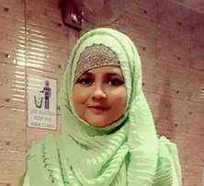
Team Name :
NWU_MSM
Details of Team Members :
Md Abu Siddik
Student Id: 20201131010
Department of CSE
North Western University
Khulna, Bangladesh
Mrittika Banerjee
Student Id: 20201140010
Department of CSE
North Western University
Khulna, Bangladesh
Tahmina Akter
Student Id: 20201148010
Department of CSE
North Western University
Khulna, Bangladesh
2

Slide 3
Overview :
Admin
User Mode
Owner Mode
Dependencies
Conclusion
Introduction
Objective
E-R Diagram
Site Tree
Project View
Login pages
3

Slide 4
Introduction :
A software which developed by Python using tkinter module
For make the rent system online based
Help anyone to find a rent easily
Help a owner to find a renter fastly
4

Slide 5
Objectives :
To make the building rent system easy and helpful
To decrease the suffering of searching buildings for rent
To save the time of searching building for rent
To find buildings easily even if one doesn't know the area
To know about extra facilities and opportunity of a building
To compare and find the best building easily
5

Slide 6
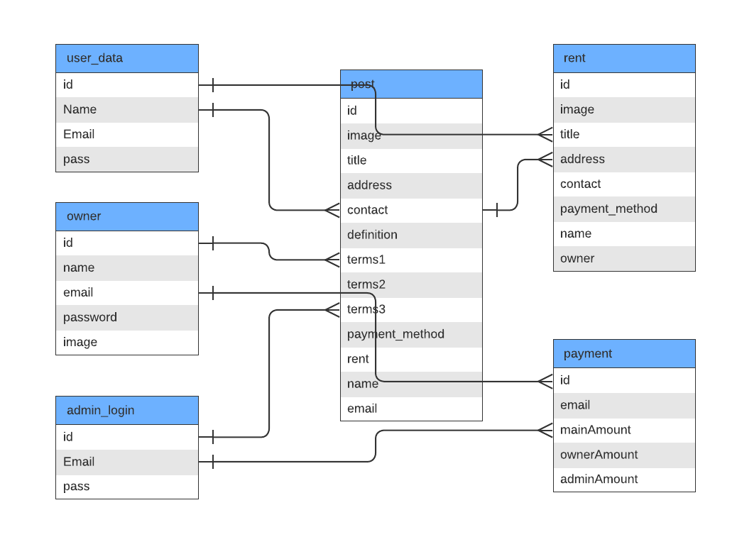
Entity Relationship Diagram:
6

Slide 7
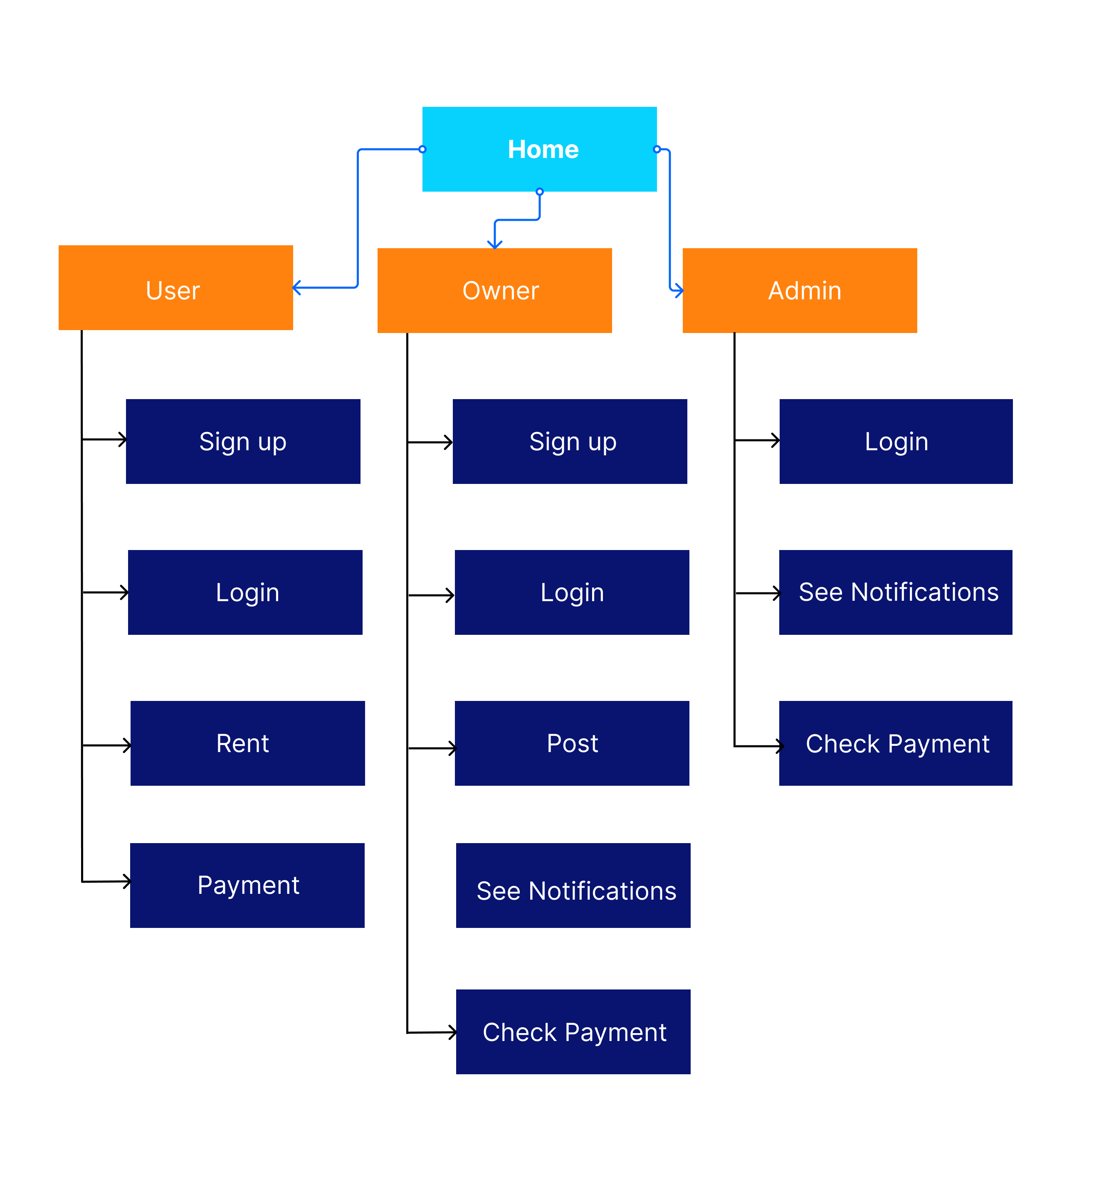
Site Tree :
The system have 3 actors.
1.Admin
2.Owner
3.User
Each actors have unique role and different interface.
7

Slide 8
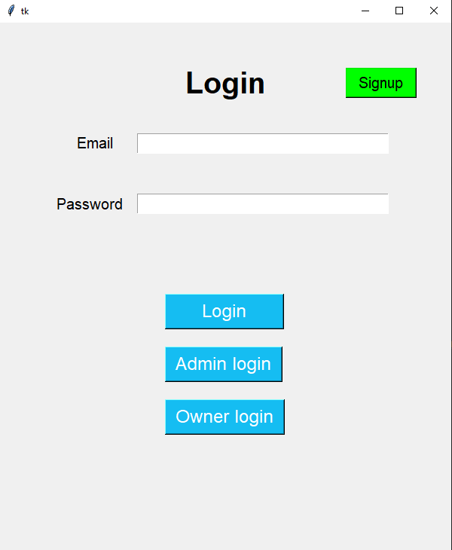
Project View
If there’s no account then one can signup
User will fill the form and click here to login
Admin will fill the form and click here to login
Owner will fill the form and click here to login
8
Login page

Slide 9
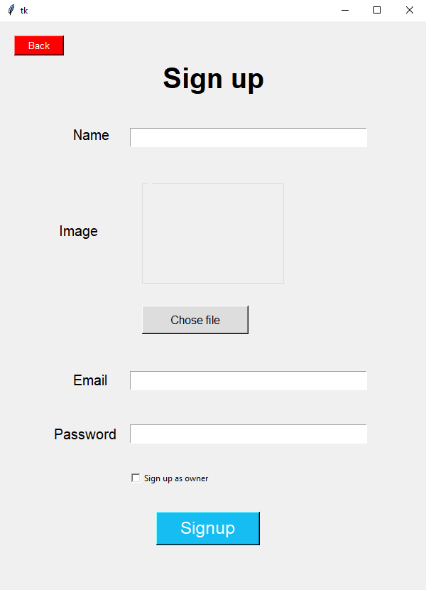
Sign up
9
Sign up page

Slide 10
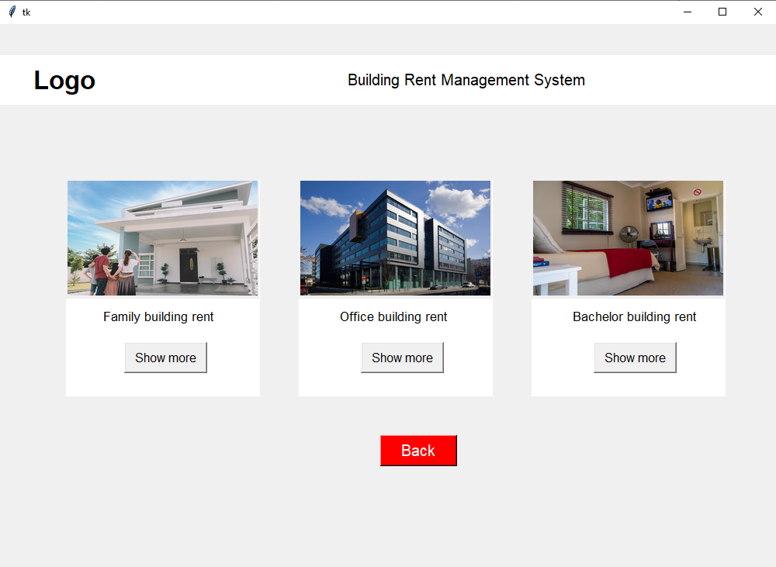
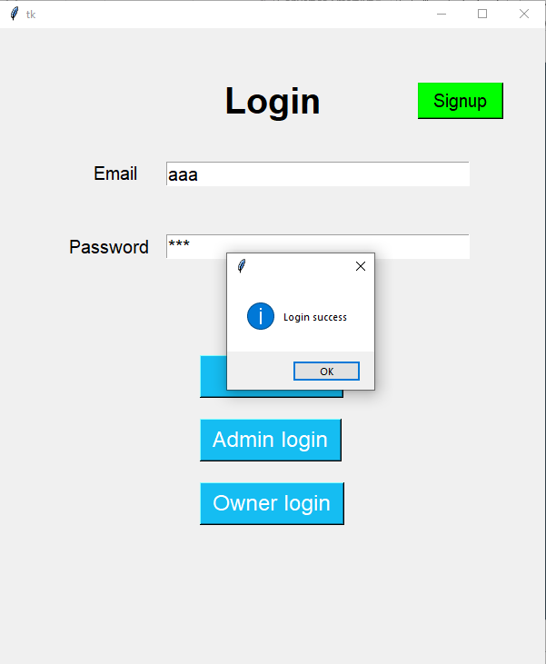
User Mode
10
User show after login

Slide 11
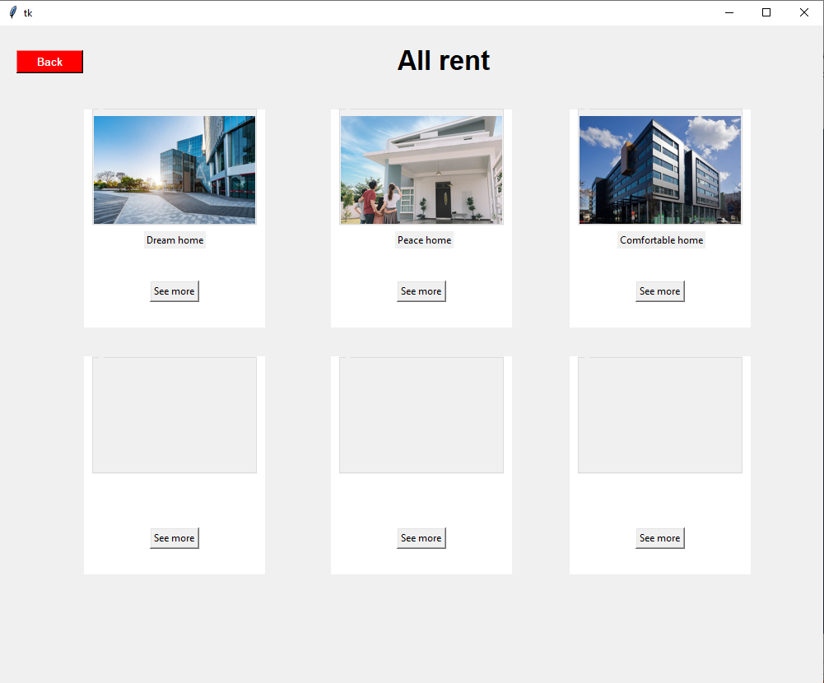
User Mode
11
Categories after login

Slide 12
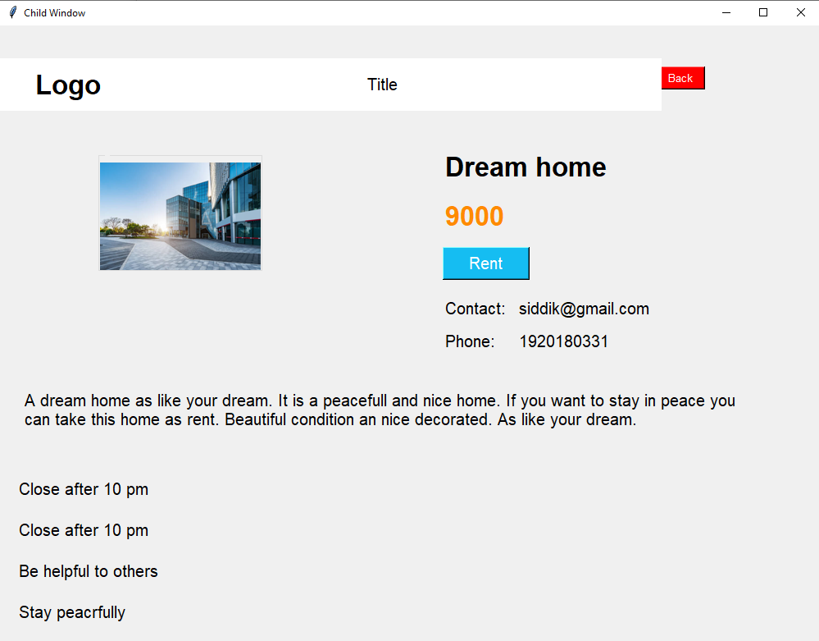
Back
12
After clicking see more

Slide 13
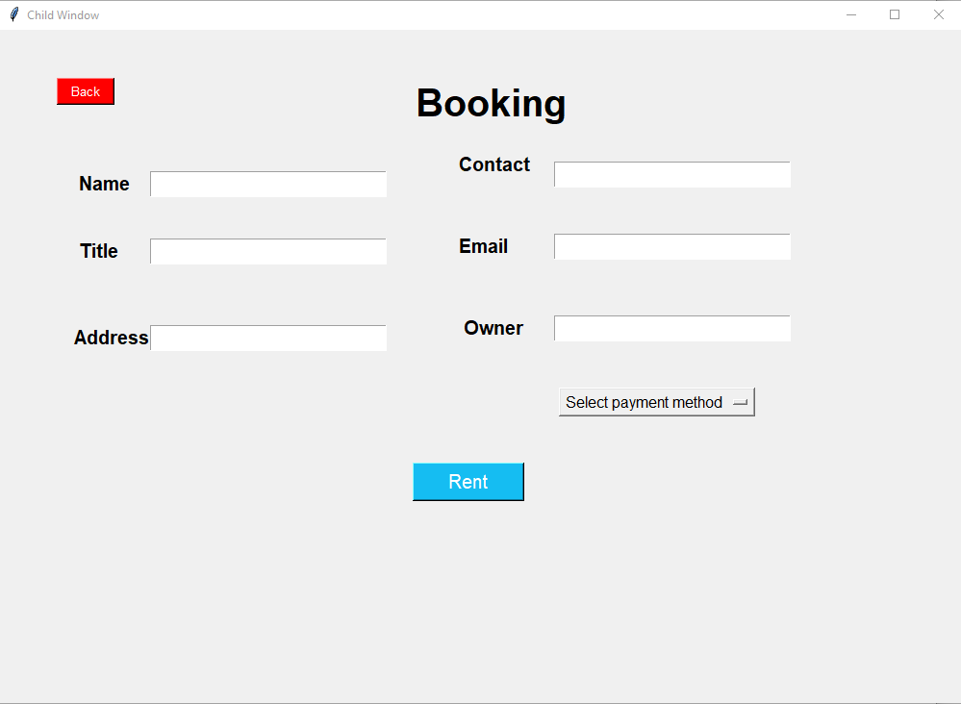
User Mode
13
After clicking Rent button

Slide 14
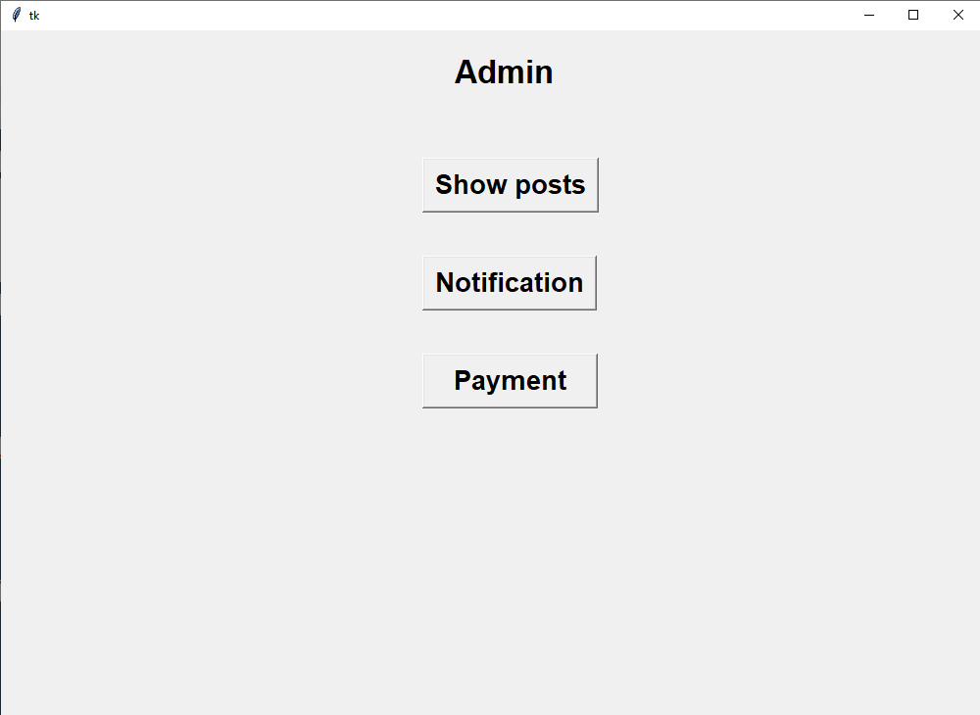
Admin Mode
14
Admin page

Slide 15
Admin Mode
15
Admin Showing posts

Slide 16
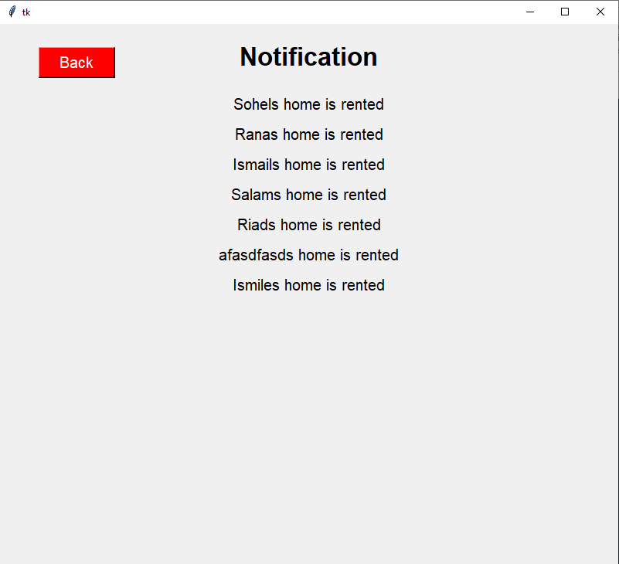
Admin Mode
16
Admin notifications

Slide 17
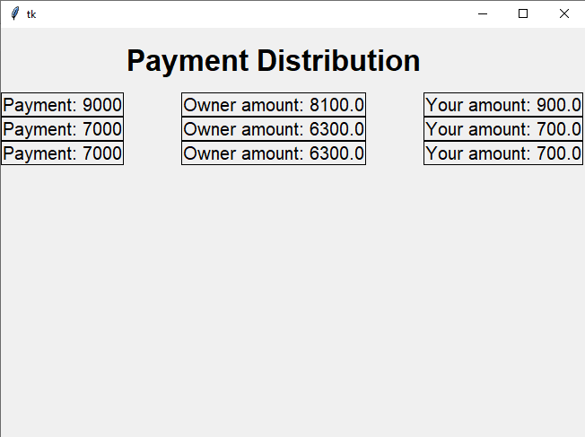
Admin Mode
17
Admin payment distribution

Slide 18
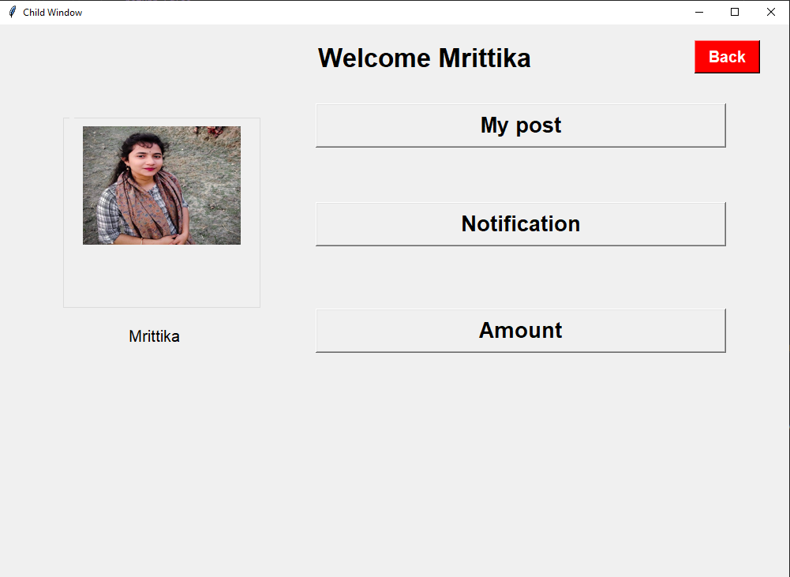
Owner Mode
18
Owner profile after login

Slide 19
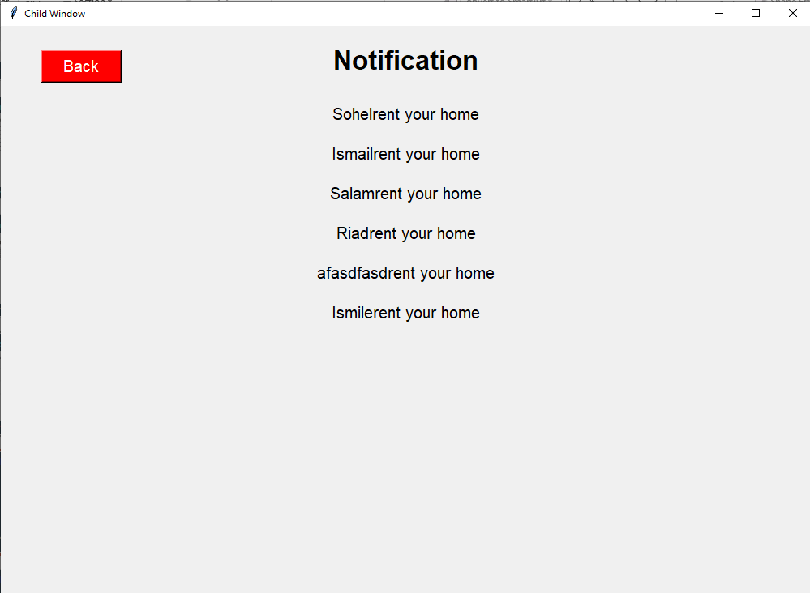
Owner mode
19
Owner notifications

Slide 20
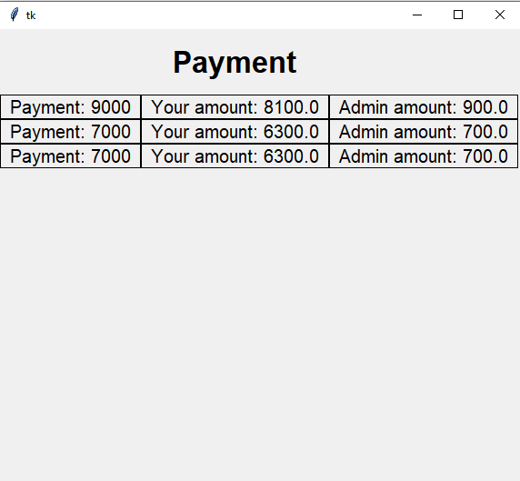
Owner mode
20
Owner payment distribution

Slide 21
Dependency :
Tkinter : Use tkinter module for user interface.
Sqlite3 : Depends on sqlite3.
Pycharm : Use pycharm as compiler.
21

Slide 22
Conclusion :
Python tkinter was new to us.
Faced some problem while maintaining owner and admins payment distribution.
Tried to make a better ER-Diagram and site tree.
A possibility of an update in the future.
22

Slide 23
Thanks!
Any questions?
You can find us at:
abusiddik84@gmail.com
mrittikabanerjee6@gmail.com
ttahminaakter4@gmail.com

